Slide 1
MECM call flows

Slide 2
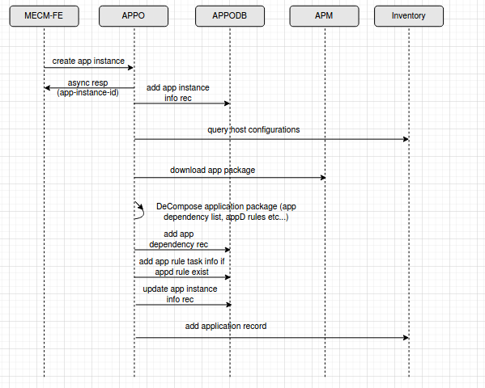
Create application instance

Slide 3
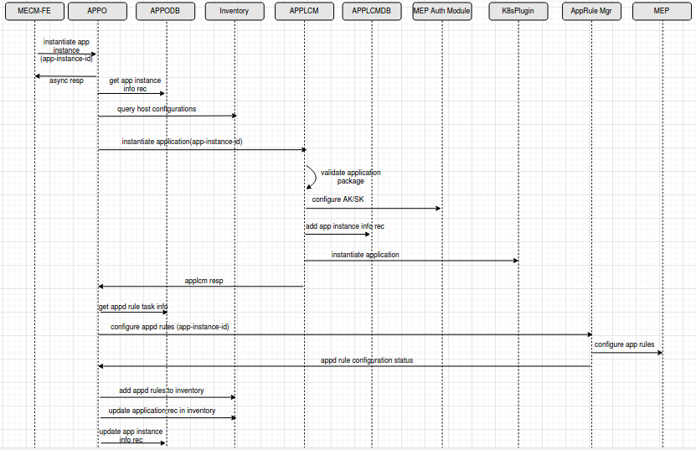
Instantiate application instance

Slide 4
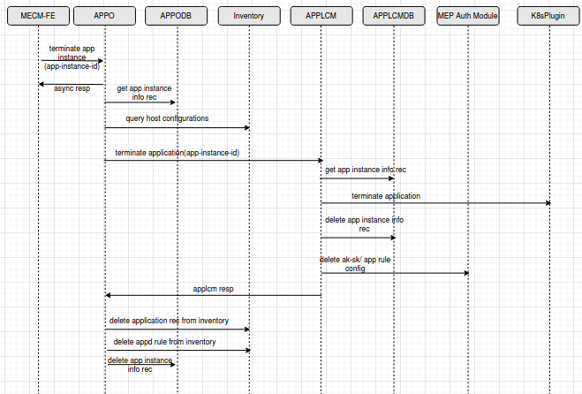
Terminate application instance

Slide 5
Thank you

